Slide 1
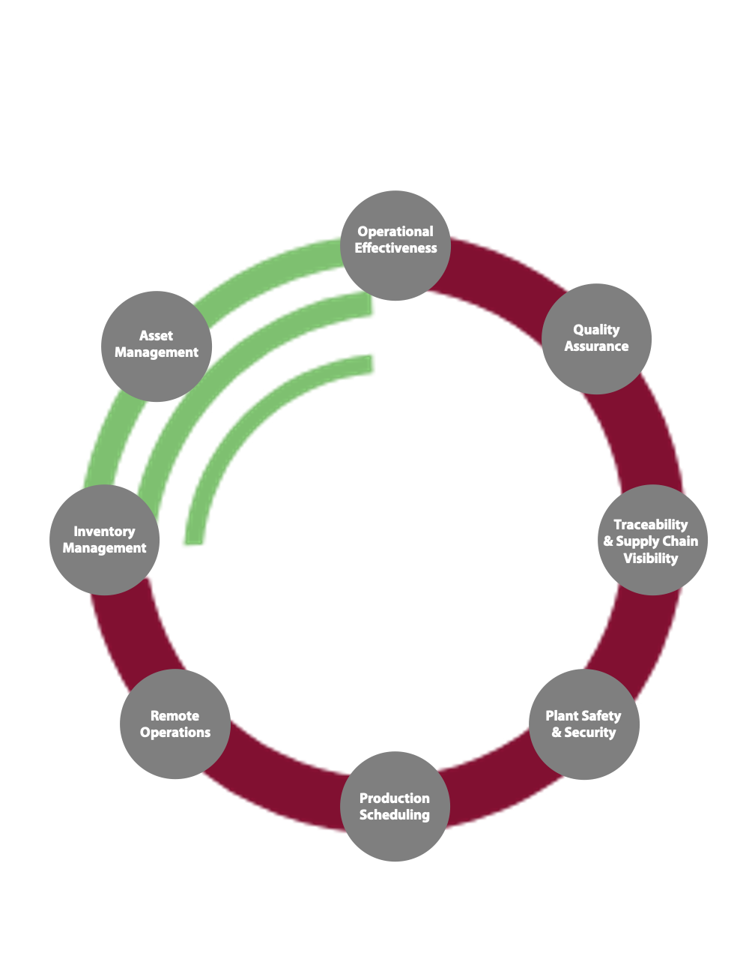



Our approach to Intelligent Automation
Inefficiencies
Identification
Analysis &
Ideation
Prioritized & road mapped list of solution
End to end implementation
Low customer satisfaction
People
Process
Operational procce too costly
Sprint 1
Low productivity and performance
Sprint 2
Compliance with quality standards
Manual operational processes
Technology
Sprint 3
Egacy and outdated software that support operations
Low KPIs

